Slide 1
控制组工作汇报
2017.3.19
Notes:
In this slide there is a background placeholder. Click to the small icon on the center of the slide and choose an image from computer. When add an image, you must sent it to back with Right Click on Image -> Send to Back -> Send to Back.

Slide 2
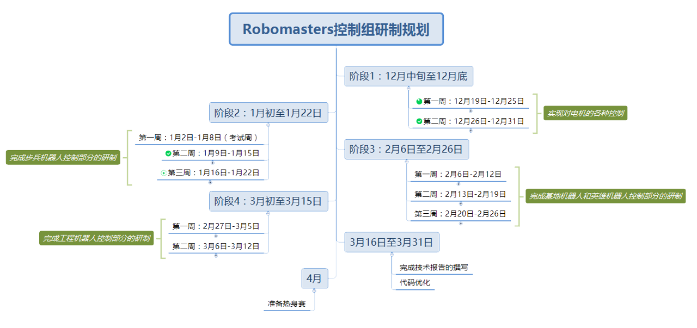
控制组研制总规划

Slide 3
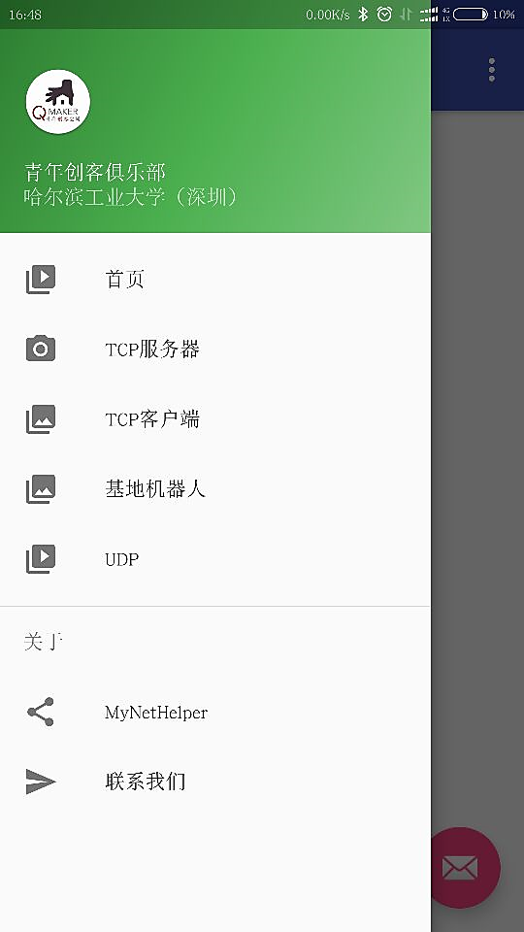
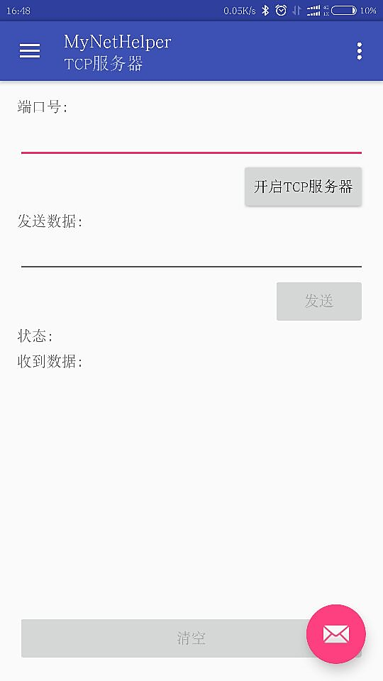
近期完成工作

Slide 4
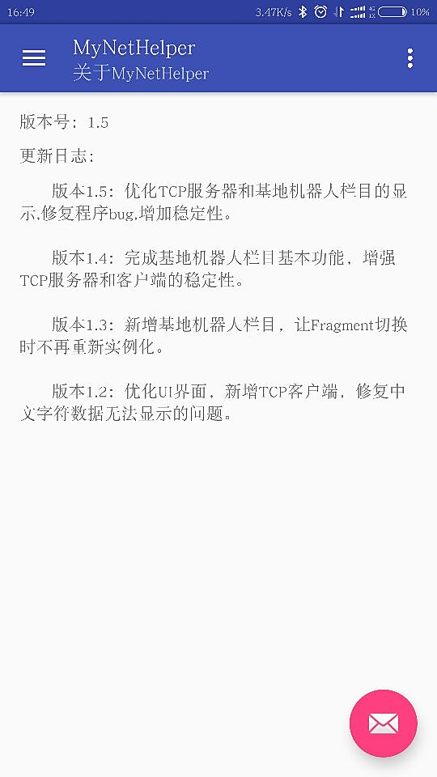
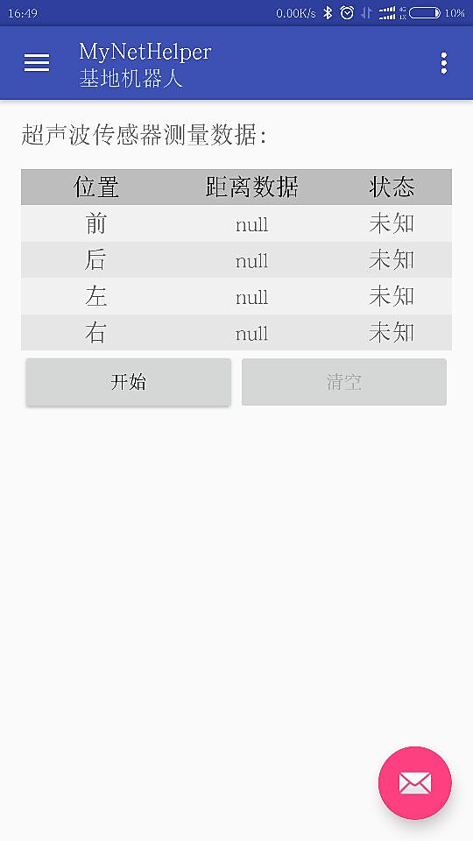
近期完成工作

Slide 5
下周任务
1、设计数字识别算法
2、手机APP的改进与优化

Slide 6
谢谢!
Notes:
In this slide there is a background placeholder. Click to the small icon on the center of the slide and choose an image from computer. When add an image, you must sent it to back with Right Click on Image -> Send to Back -> Send to Back.

